Slide 1
Name: Sourav Neupane Student id: 202039089 Subject: Database system

Slide 2
Goal
1. Data into information.
2. Information into knowledge.
3. Knowledge of the action.

Slide 3

Table of contents
Problem Statement
Context Level Diagram
ERD
EERD
Normalization
Physical database design
Conclusion
References

Slide 4
Problem Statement
There’s a brewery where thousands of beer bottles are manufactured. It consists of five departments, namely bottling, brewing, quality, hr, account. Each department has its own head, butis guided by one head(brewer) . Apart from that there is maintainence team and plant manager. And, at the end of beer production and bottling, and packaging, the distributors help the company to distribute the beer cartoon, who are only given permission to dispatch by the inspector after he/she inspects each bottle and packaging conditions.
Output :
1 head brewer who controls all the departments.
Maintainence team who are available all the time during working hours in order to quick overhaul.
One plant manager who decides the location of a plant to be planted and are involved In daily activities for the company long-range plans.
Atleast 2 inspector who check the oacking conditions of beer i.e quantity, logistic stickers, barcodes etc and is denoted as (Q,B,L) in diagram.

Slide 5
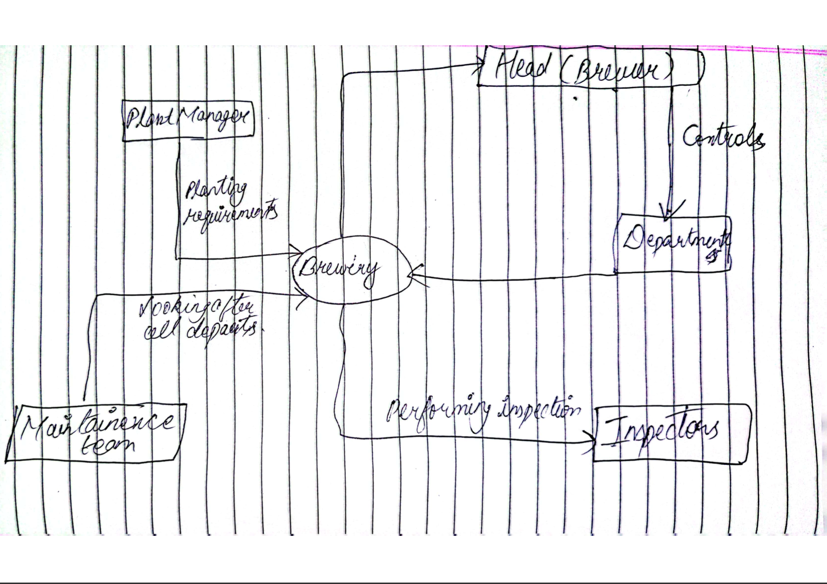
Context Level Diagram

Slide 6
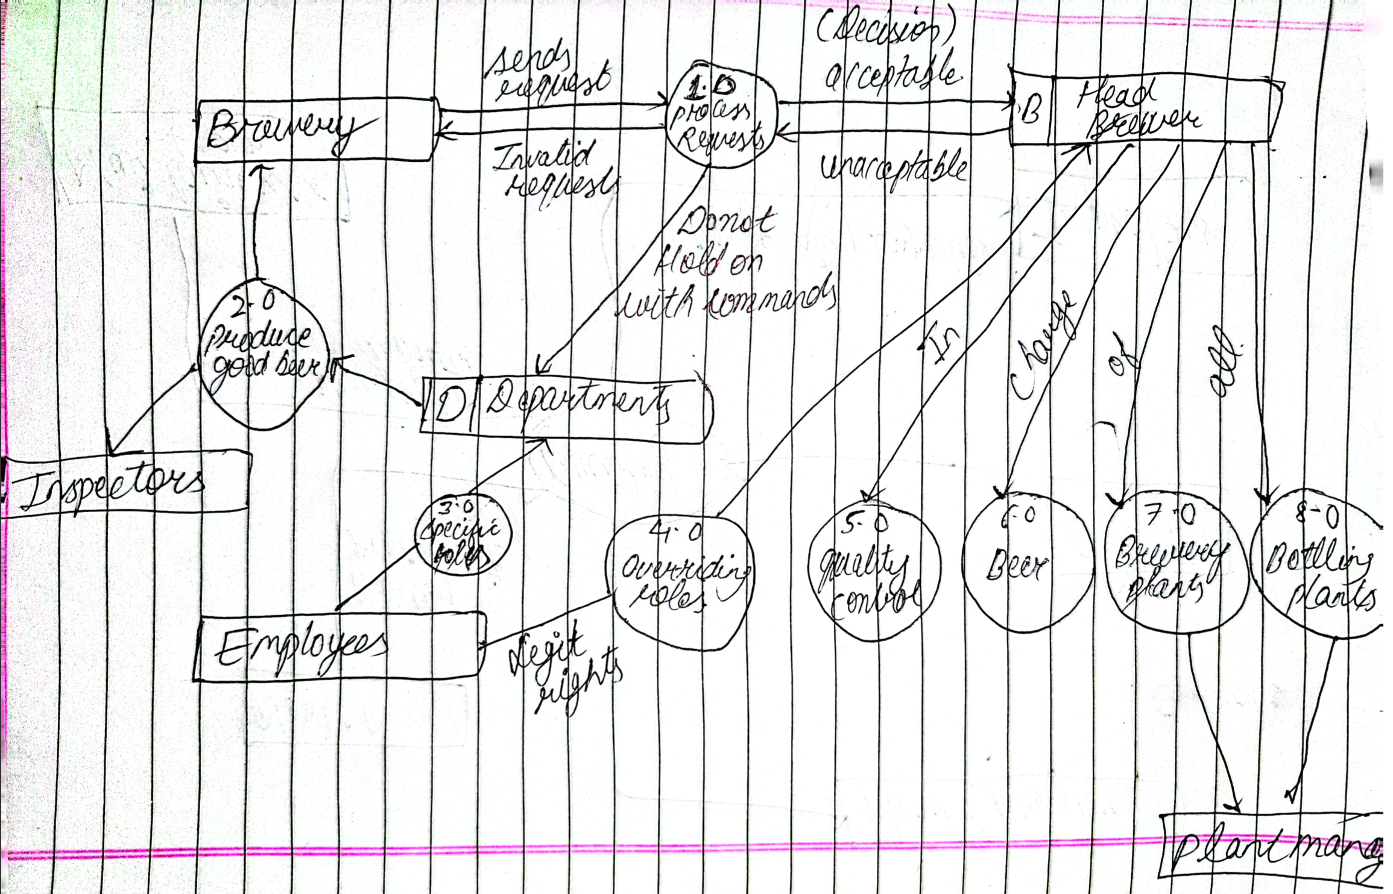
DFD Level 0 Diagram

Slide 7
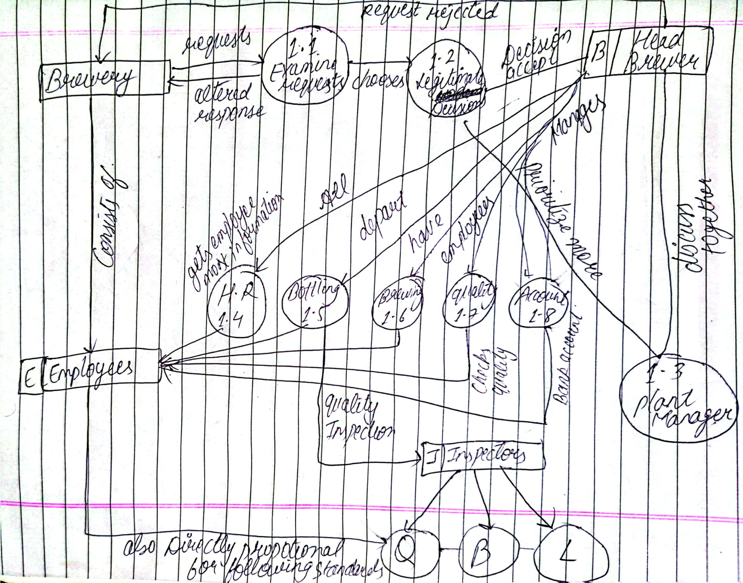
DFD Level 1 Diagram

Slide 8
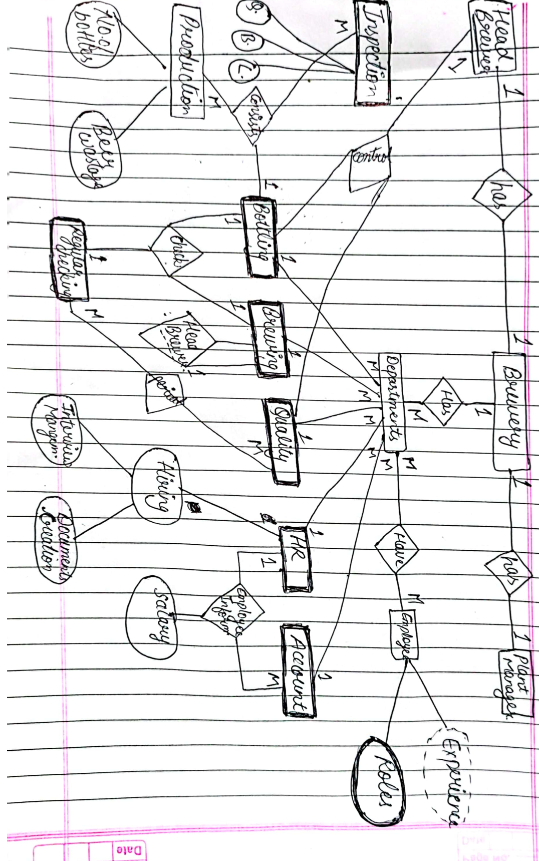
ERD

Slide 9
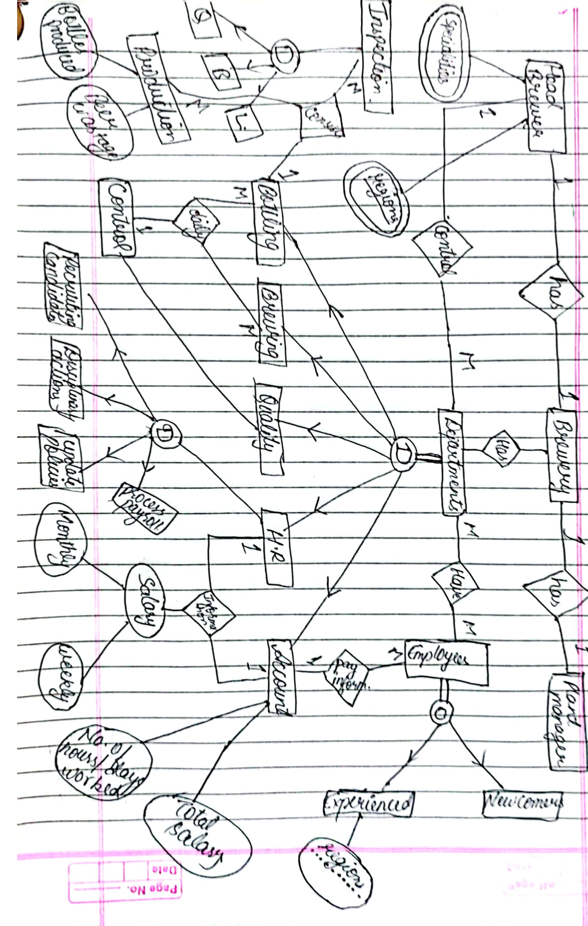
EERD

Slide 10
Normalization

Slide 11
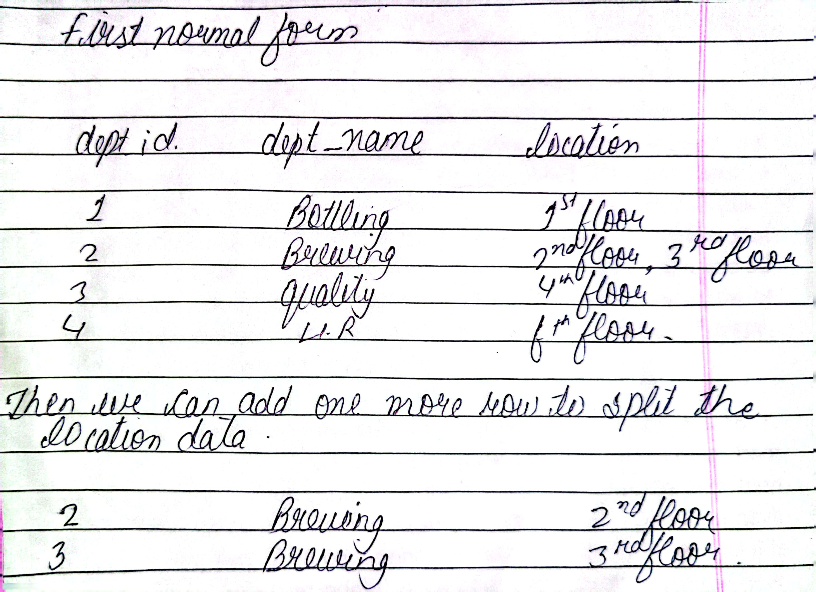
1st NF

Slide 12
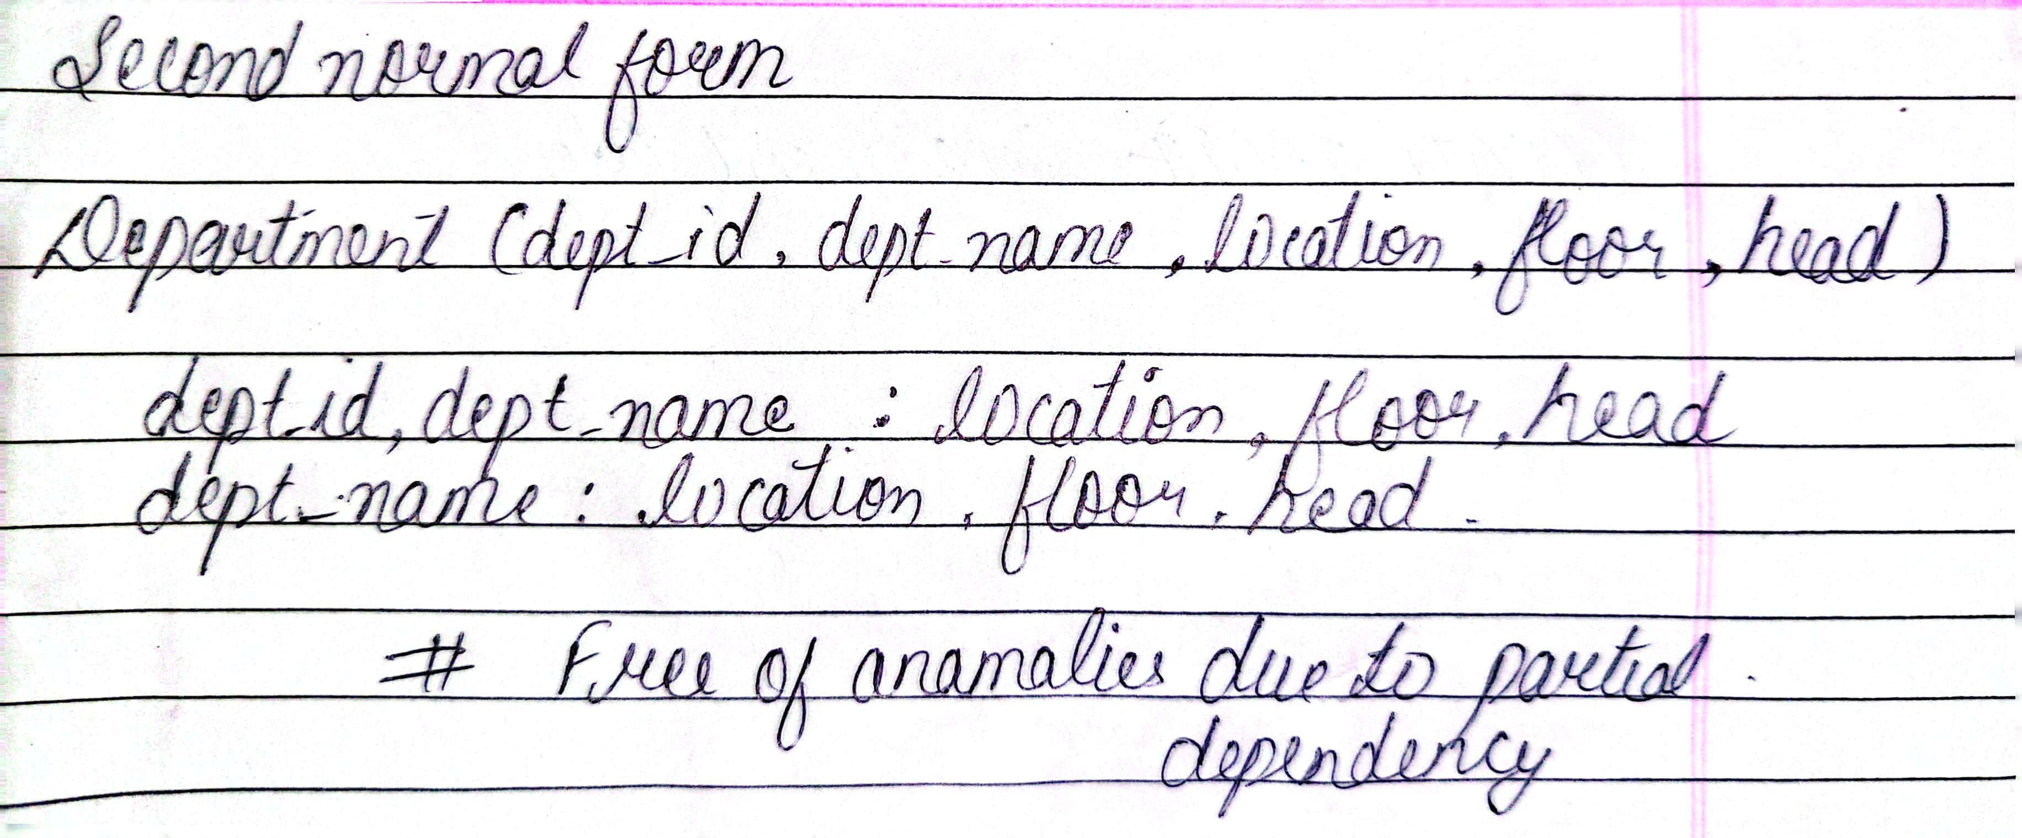
2nd NF

Slide 13
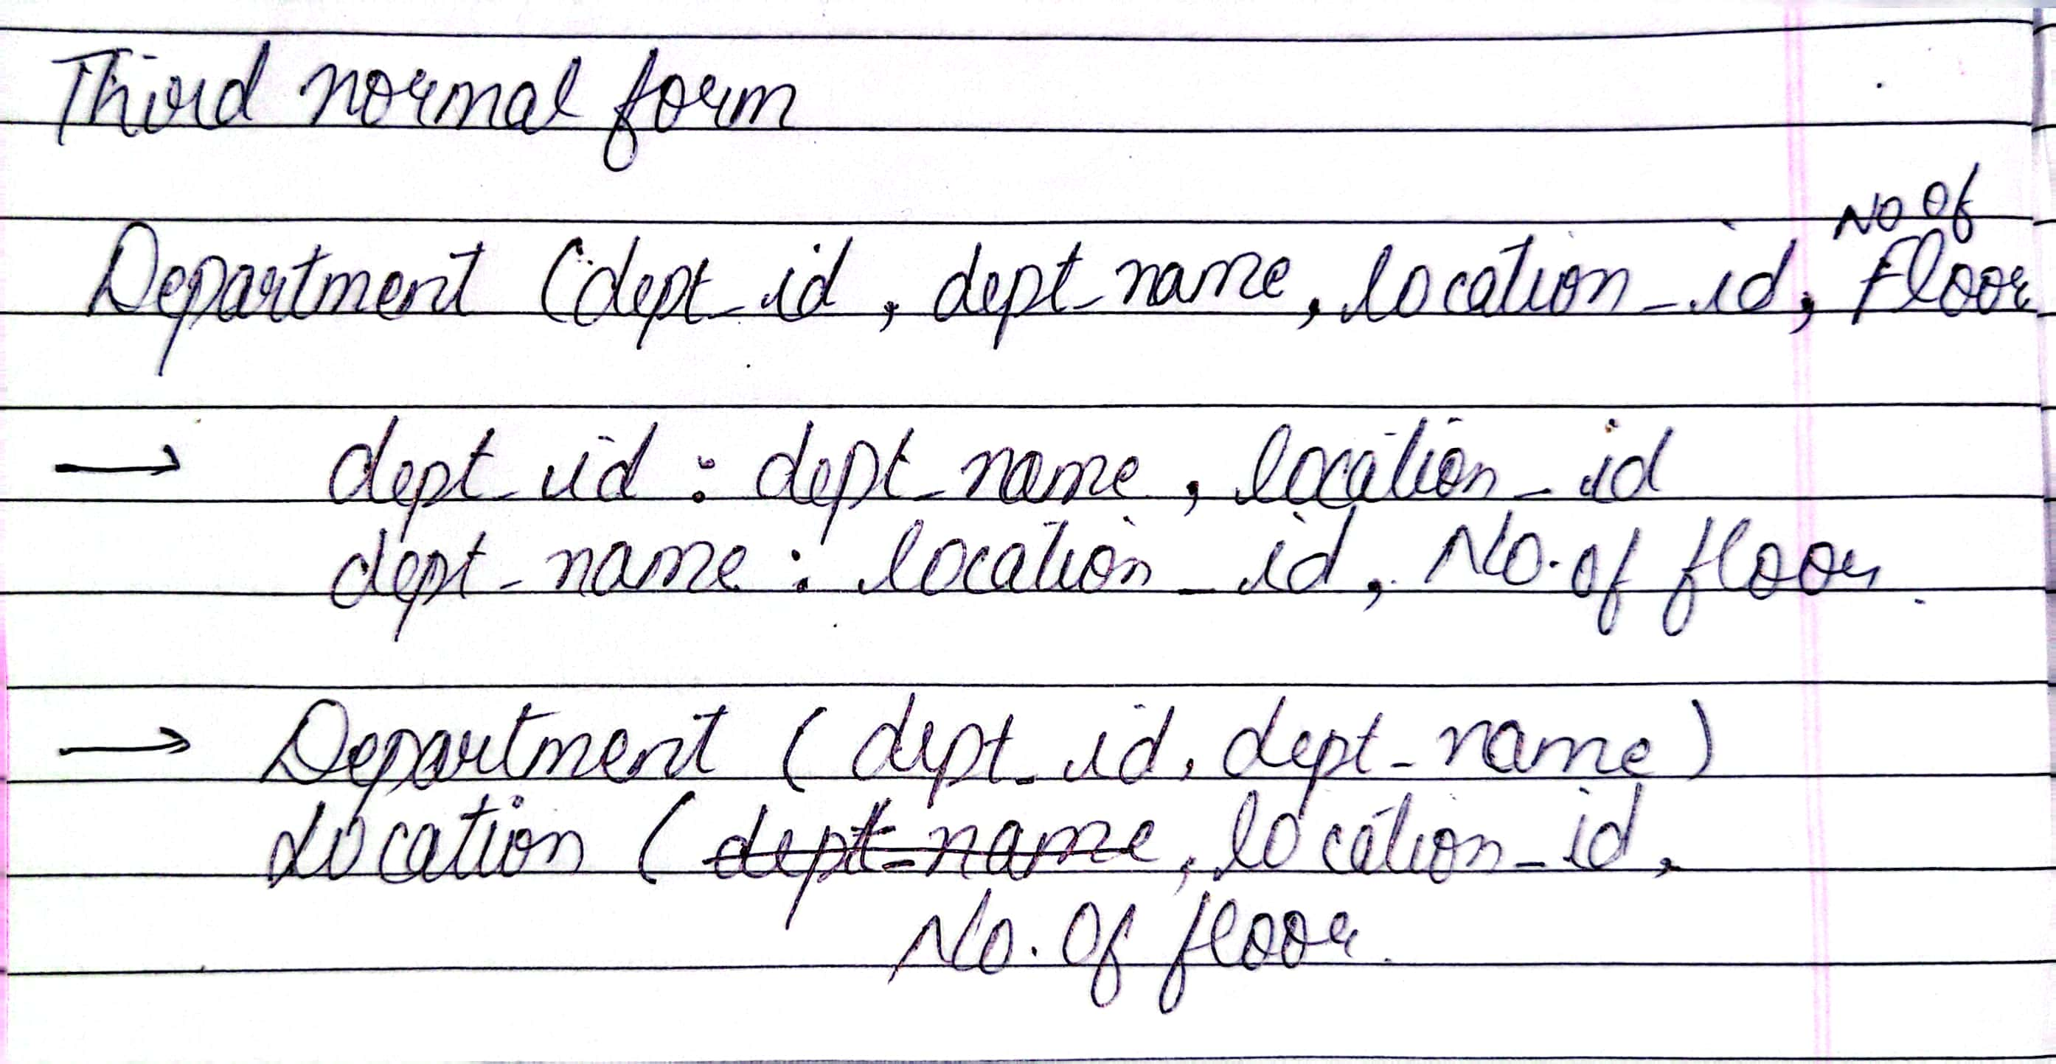
3rd NF

Slide 14
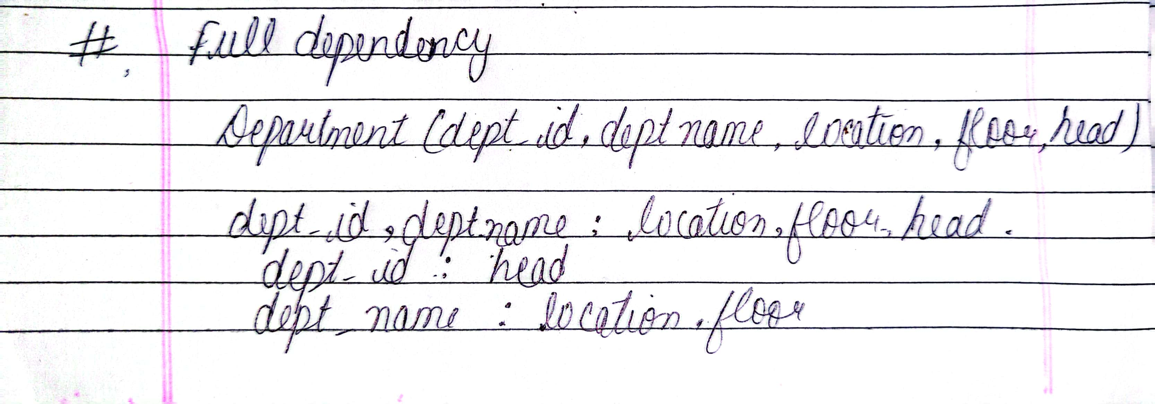

Slide 15
Physical Database Design

Slide 16
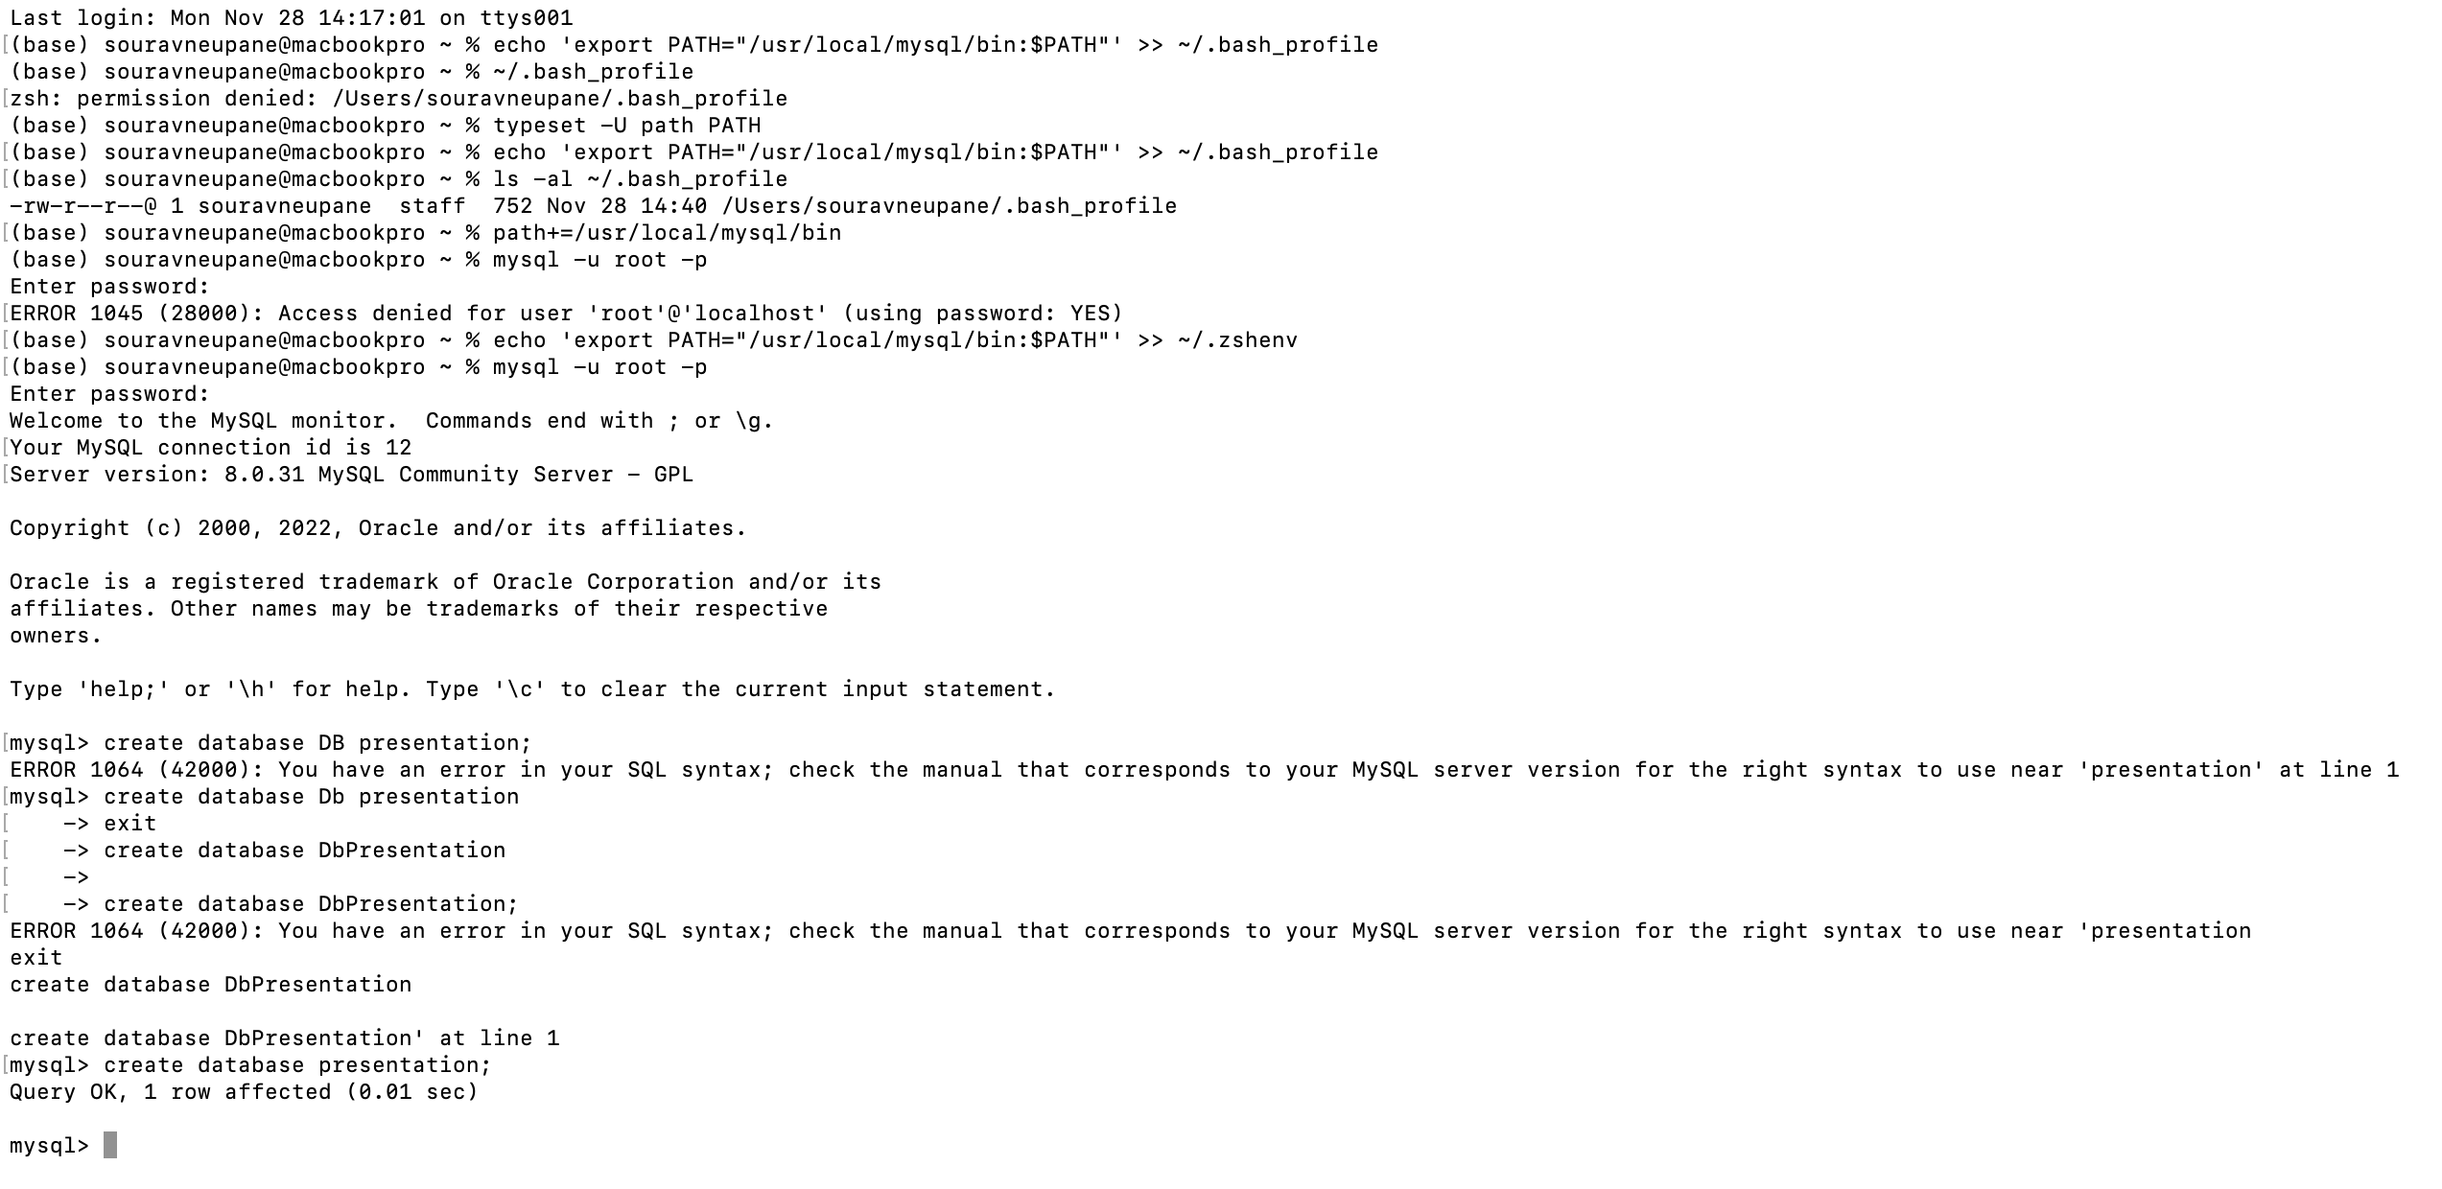
Query and screenshot of create database

Slide 17
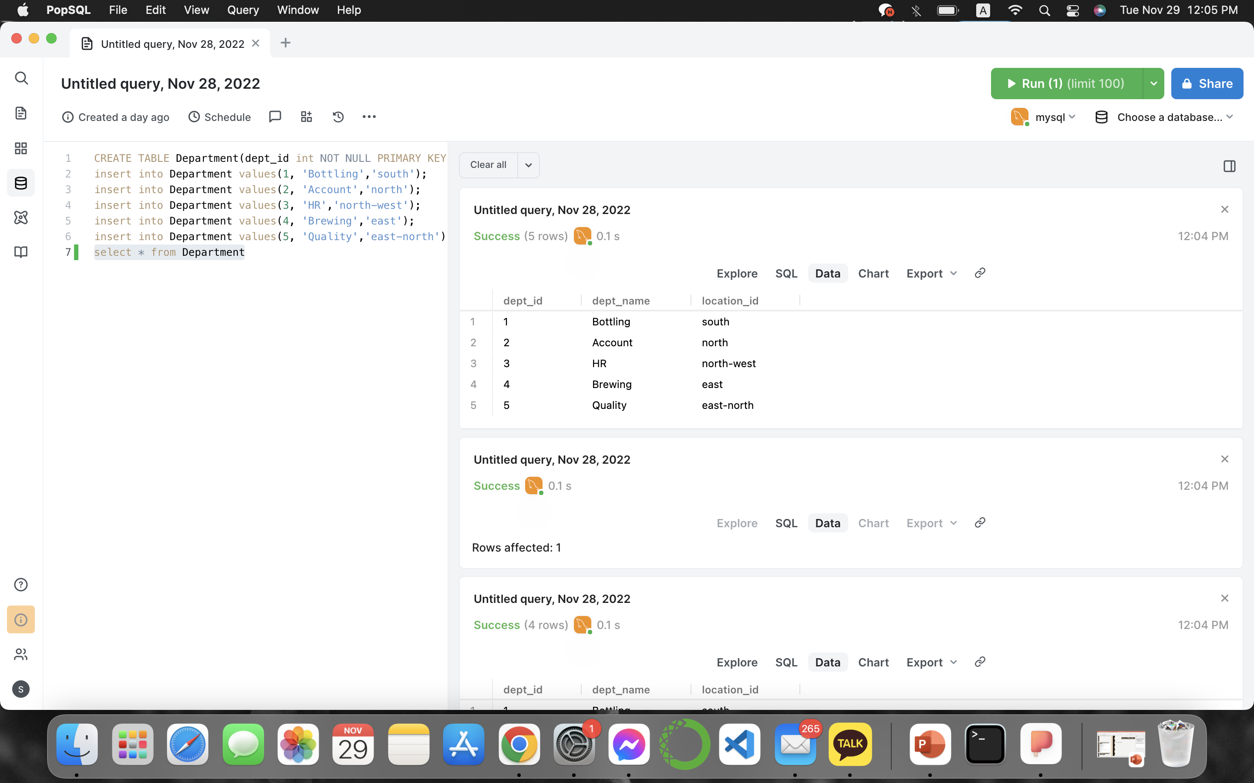
Query and screenshot of create and insert in tables

Slide 18
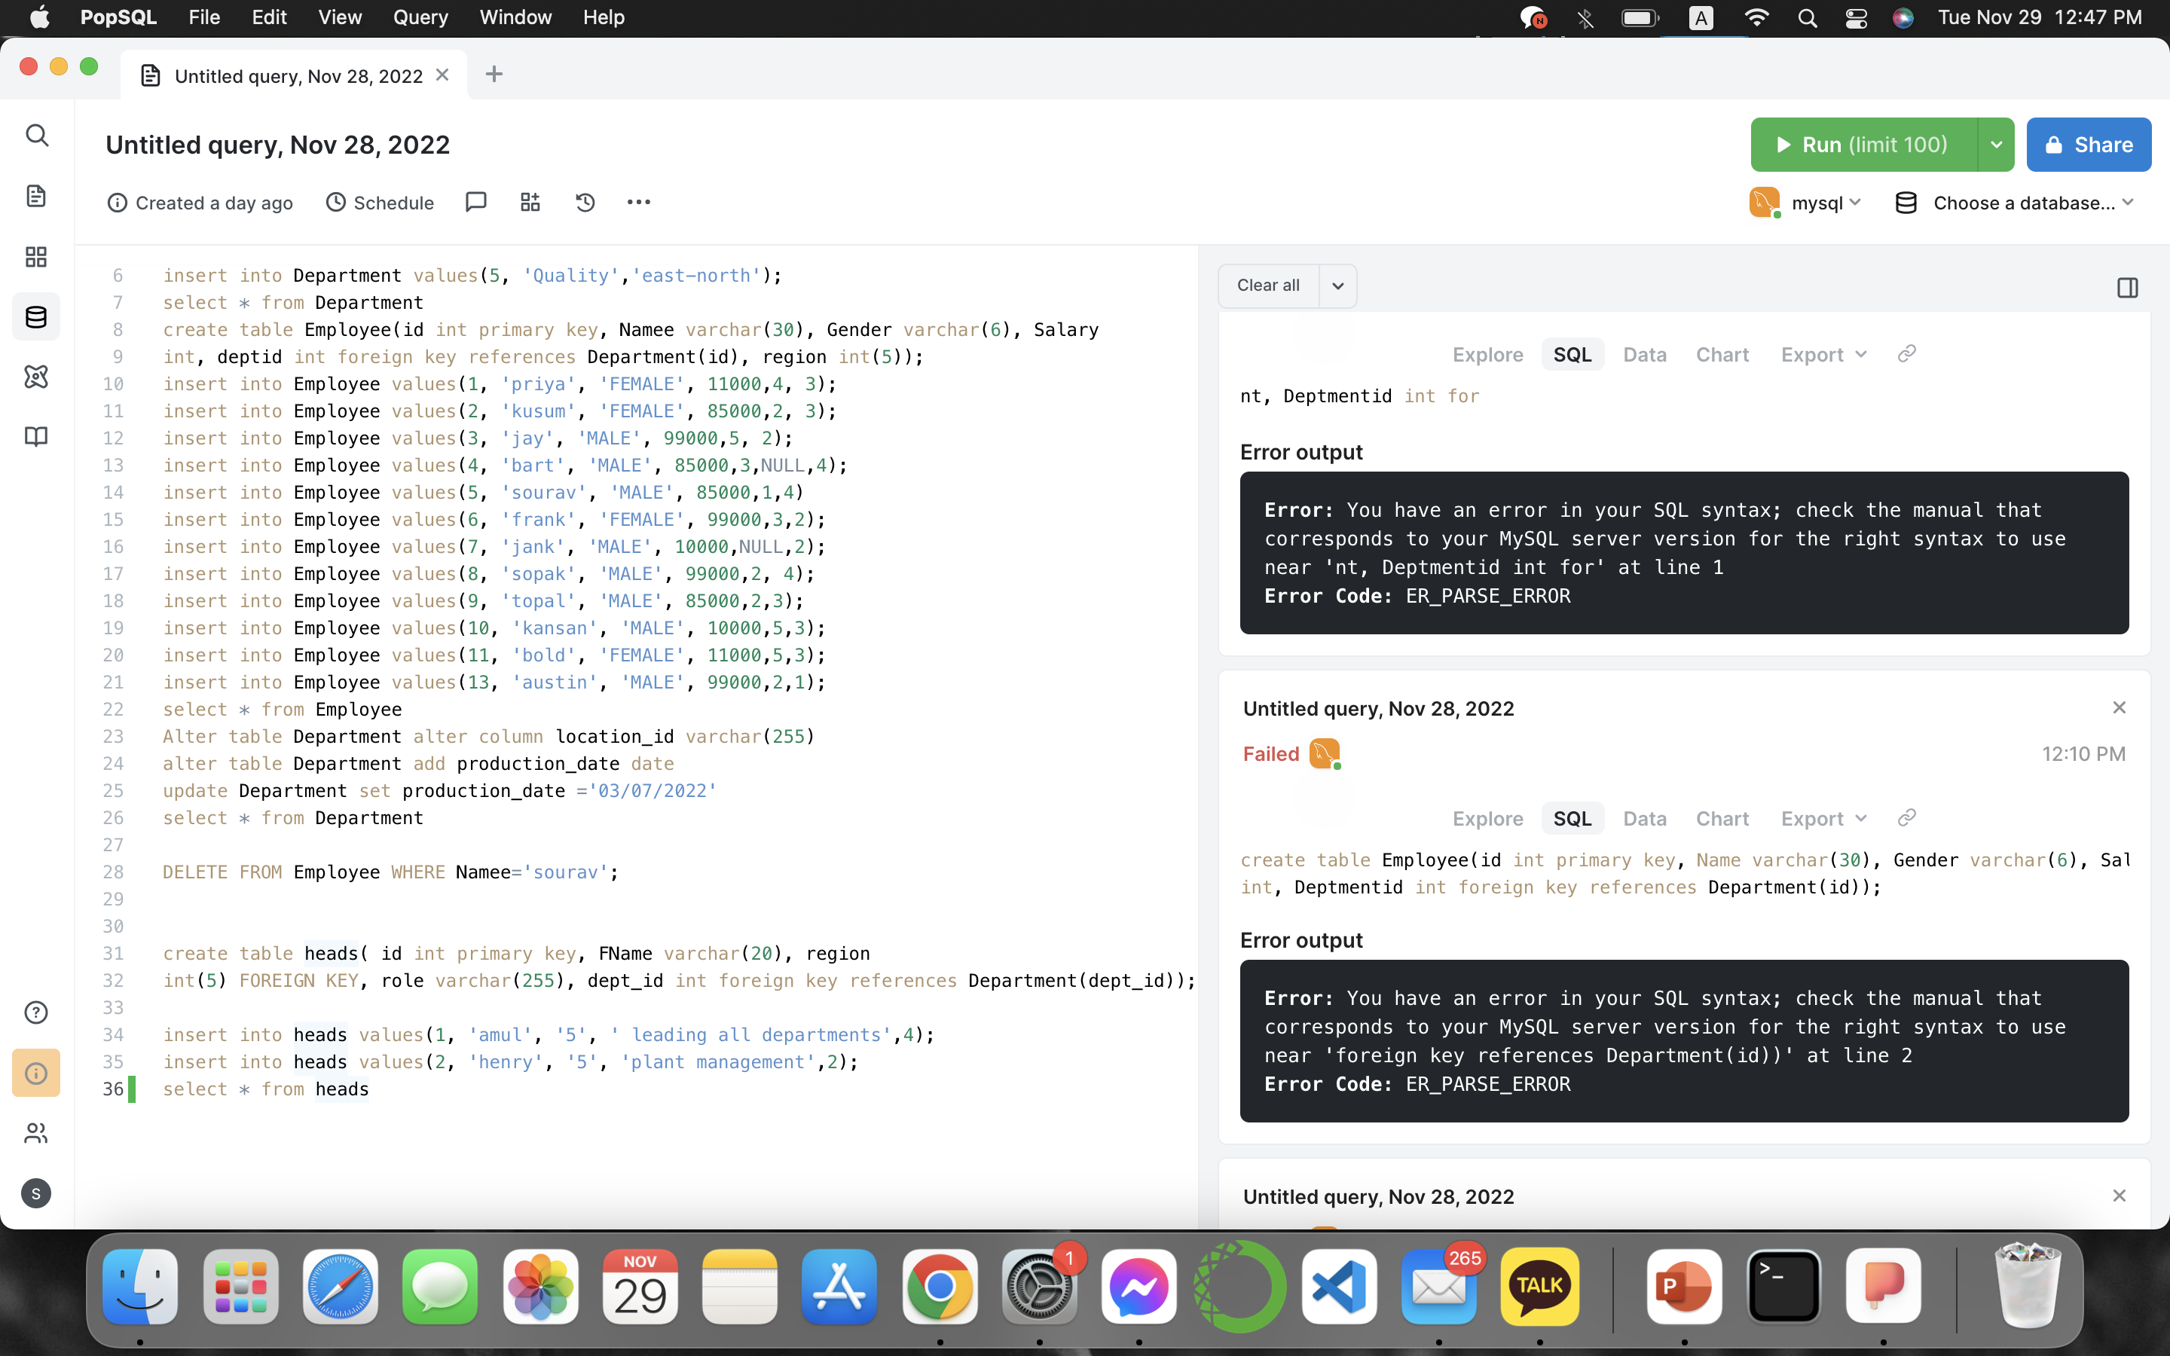
Query and screenshot of Delete Table

Slide 19

Query and screenshot of types of joins

Slide 20
Conclusion
In conclusion, Databases were made to make our lives a little easier. Databases help us maintain information needed daily success. Another reason why Database systems were made, so that companies could keep up with massive amounts of information in a singular place. Queries help find this data faster by punching in key words. This helps productivity in a workplace. Forms are made to store the reports, so we have the information required to present to others. There are serious threats out there. Without proper monitoring these issues can become major problems if companies do not catch them in time.

Slide 21
References
https://www.youtube.com/watch?v=HXV3zeQKqGY&t=5172s
https://stackoverflow.com/questions/35858052/how-to-fix-command-not-found-mysql-in-zsh
https://stackoverflow.com/questions/17975120/access-denied-for-user-rootlocalhost-using-password-yes-no-privileges
https://apple.stackexchange.com/questions/401725/echo-export-path-usr-local-mysql-binpath-bash-profile-by-using-this

Slide 22
THANK YOU !!!!!

